Slide 1
Chapter VI: Machine Learning

Slide 2
Outline
Concept of Learning
Learning By Analogy
Boltzmann Machines
Fuzzy Logic
Neural Network
Genetic Algorithm

Slide 3
Learning
Acquiring new knowledge- knowledge acquisition
Modifying old knowledge, behaviour, skills- skill refinement
May involve synthesizing different types of information
Learning is also based on feedbacks

Slide 4
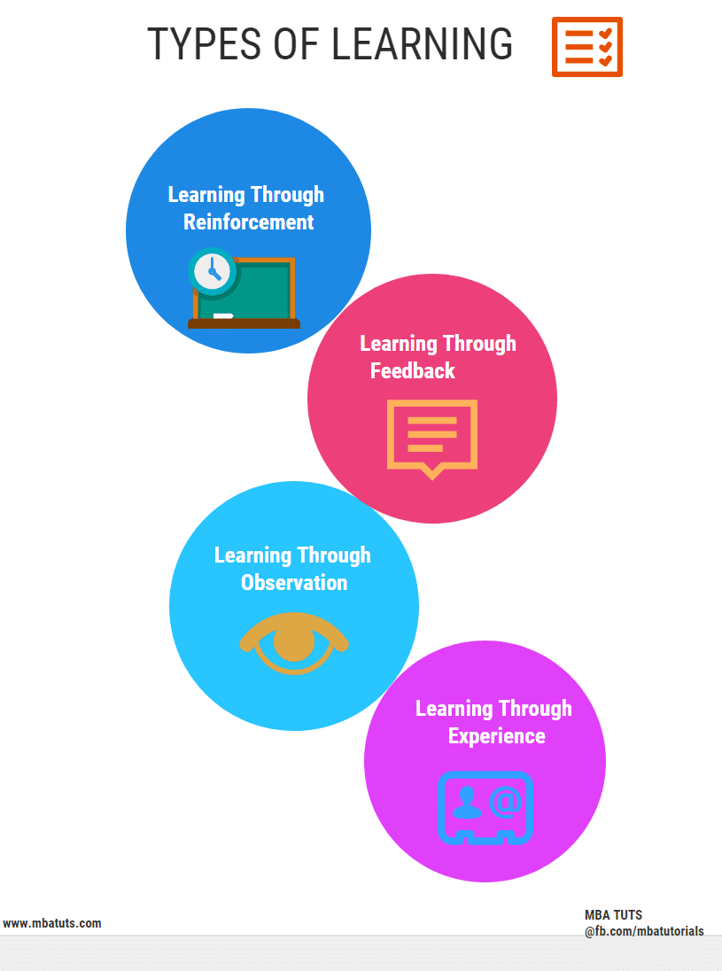

Slide 5
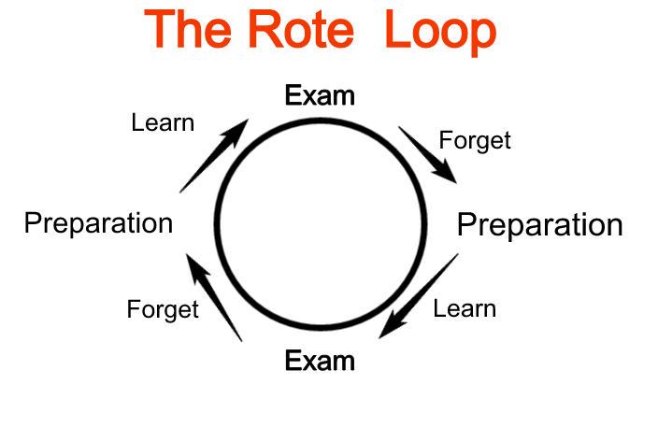
Types of Learning
Rote Learning
  Rote learning is a technique which focuses on memorization
  It avoids understanding the inner complexities and inferences of the subject that is being learned and instead focuses on memorizing the material
  The major practice involved in rote learning is repetition
  Here, data is stored in the brain without necessarily understanding it. One should be able to recall material quicker the more one repeats it. Rote memorization isn’t considered higher-level thinking or critical thinking since students don’t learn how to think, analyze or solve problems with this type of learning.

Slide 6
Types of Learning
Inductive Learning
  Determine general pattern, rules and facts
  Mainly example or experienced
based learning
Deductive Learning
  Determine specific patterns, rules and facts
  New rules are generated from old
one

Slide 7
Machine Learning
Branch of AI that use algorithms to allow computer to evolve behaviours based on data collected from database or gathered through sensors
Focuses on prediction, based on known properties learned from the training data
The performance is usually evaluated with respect to the ability to reproduce known knowledge

Slide 8
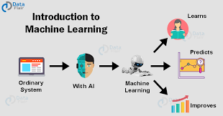

Slide 9
Machine Learning
Different cases of machine learning
  Supervised learning: inputs and corresponding outputs are bind together
  Unsupervised learning: only inputs are available for the learner
  Reinforcement learning: learning based on reward or punishment

Slide 10
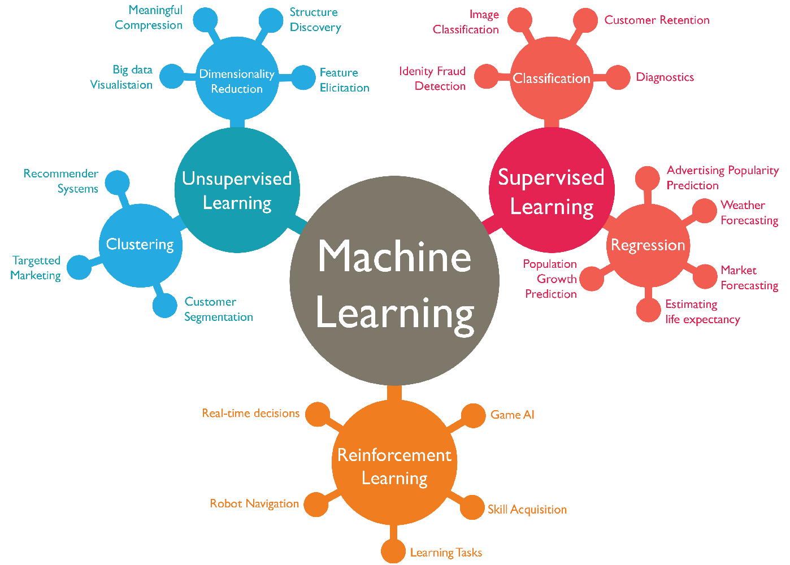

Slide 11
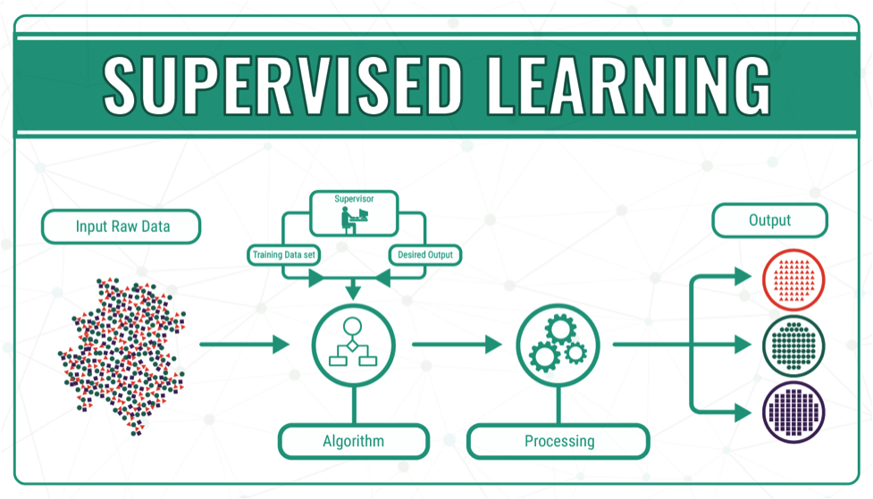

Slide 12
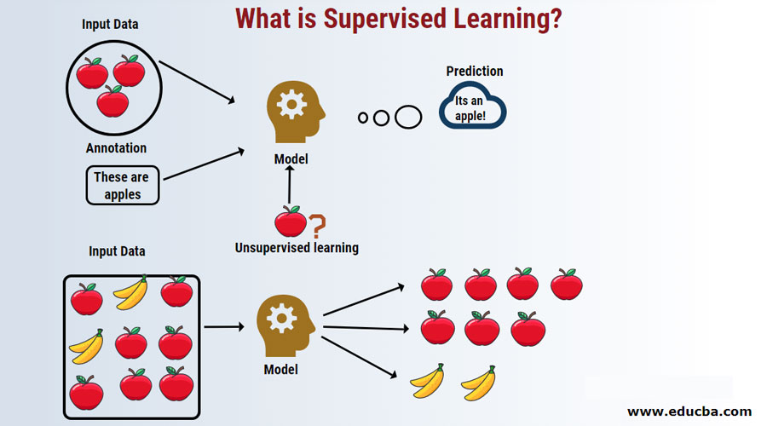

Slide 13
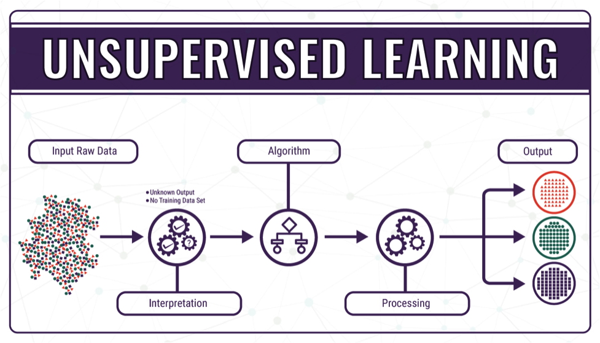
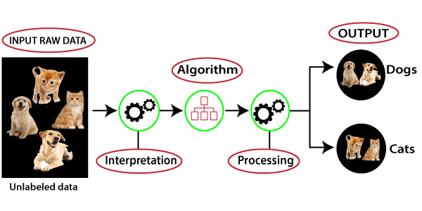

Slide 14
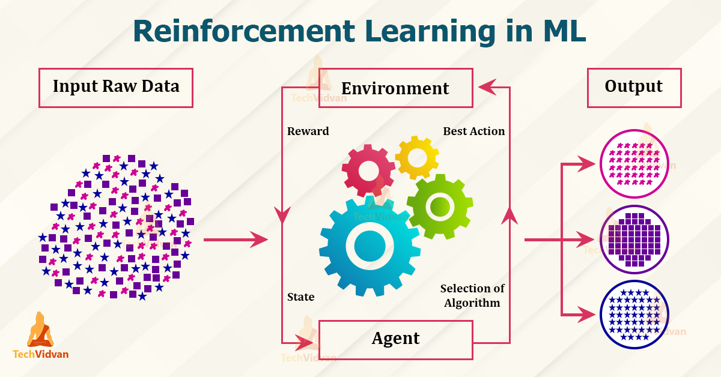

Slide 15
i. Inductive learning, also known as discovery learning, is a process where the learner discovers rules by observing examples. ii. This is different from deductive learning, where students are given rules that they then need to apply iii. It is a supervised learning method
Inductive Learning

Slide 16
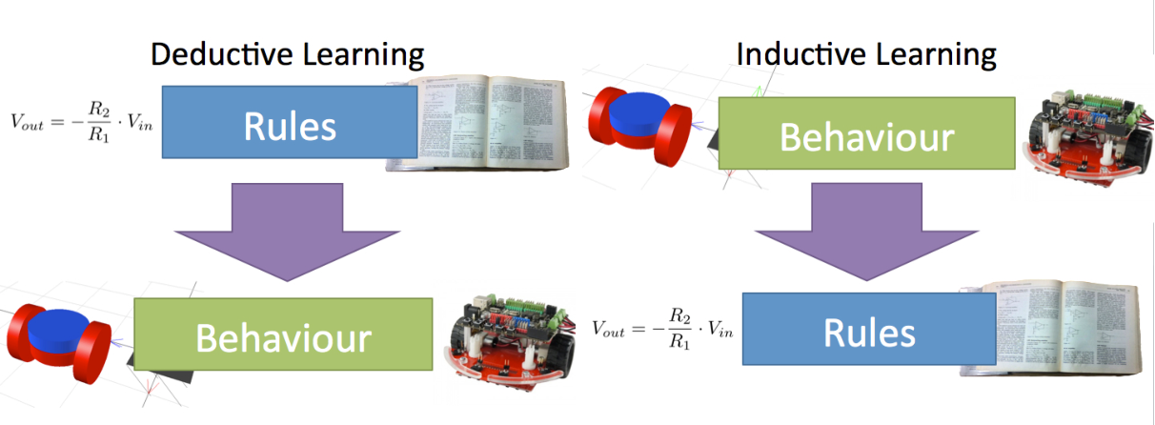

Slide 17
Learning by Examples: Induction
Based on classification of problems prior to solving
Based on induction of result
Based on generic facts, rules and patterns
Also called concept learning
Approaches:
  Winston’s Learning Program
  Version Space
  Decision Tree

Slide 18
Decision Tree
Uses a tree representation of concepts
Decision trees in artificial intelligence are used to arrive at conclusions based on the data available from decisions made in the past
Problem is started at the top of the tree and solution is identified at the leaf
ID3 is a common way of programming to build decision trees

Slide 19
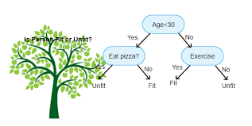
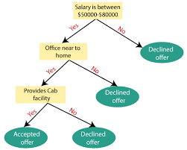

Slide 20
Iterative Dichotomizer 3
ID3 stands for Iterative Dichotomizer 3 and is named such because the algorithm iteratively (repeatedly) dichotomizes(divides) features into two or more group at each stage
ID3 is an algorithm used in decision tree learning to generate decision trees
A decision tree consists of decision nodes and leaf nodes and are connected by arcs
ID3 builds the tree from the top down greedy approach with no backtracking
Information gain is used to select the most useful attribute of classification

Slide 21
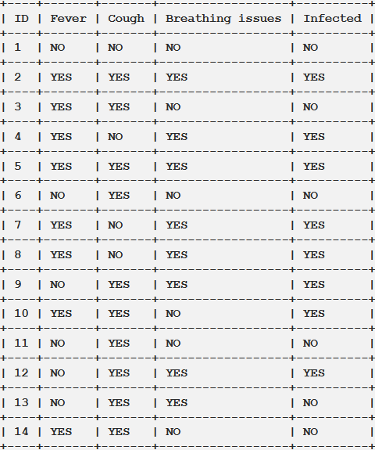

Slide 22
ID3
Information gain is calculated from entropy calculation
Entropy(S) = - ∑ pᵢ * log₂(pᵢ) ; i = 1 to n
Information Gain for a feature column A is calculated as:
IG(S, A) = Entropy(S) - ∑((|Sᵥ| / |S|) * Entropy(Sᵥ))
Where, N_{p} is of positive instances and N_{n} is that of negative instances
n is the total number of classes in the target column (in our case n = 2 i.e YES and NO)
pᵢ is the probability of class ‘i’ or the ratio of “number of rows with class i in the target column” to the “total number of rows” in the dataset.
Information Gain for a feature column A is calculated as:
where Sᵥ is the set of rows in S for which the feature column A has value v, |Sᵥ| is the number of rows in Sᵥ and likewise |S| is the number of rows in S.

Slide 23
As stated in the previous section the first step is to find the best feature i.e. the one that has the maximum Information Gain(IG). We’ll calculate the IG for each of the features now, but for that, we first need to calculate the entropy of S
From the total of 14 rows in our dataset S, there are 8 rows with the target value YES and 6 rows with the target value NO. The entropy of S is calculated as:
Entropy(S) = — (8/14) * log₂(8/14) — (6/14) * log₂(6/14) = 0.99
We now calculate the Information Gain for each feature:
IG calculation for Fever:
In this(Fever) feature there are 8 rows having value YES and 6 rows having value NO.
As shown below, in the 8 rows with YES for Fever, there are 6 rows having target value YES and 2 rows having target value NO.

Slide 24
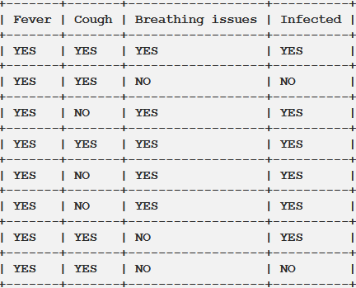
As shown below, in the 6 rows with NO, there are 2 rows having target value YES and 4 rows having target value NO.

Slide 25
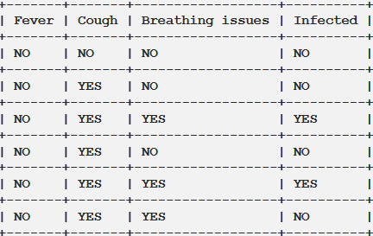
The block, below, demonstrates the calculation of Information Gain for Fever.
# total rows
|S| = 14 For v = YES, |Sᵥ| = 8
Entropy(Sᵥ) = - (6/8) * log₂(6/8) - (2/8) * log₂(2/8) = 0.81For v = NO, |Sᵥ| = 6
Entropy(Sᵥ) = - (2/6) * log₂(2/6) - (4/6) * log₂(4/6) = 0.91
# Expanding the summation in the IG formula:
IG(S, Fever) = Entropy(S) - (|Sʏᴇꜱ| / |S|) * Entropy(Sʏᴇꜱ) -
(|Sɴᴏ| / |S|) * Entropy(Sɴᴏ)
∴ IG(S, Fever) = 0.99 - (8/14) * 0.81 - (6/14) * 0.91 = 0.13

Slide 26

IG(S, Cough) = 0.04
IG(S, BreathingIssues) = 0.40
Since the feature Breathing issues have the highest Information Gain it is used to create the root node.
Hence, after this initial step our tree looks like this:
Next, from the remaining two unused features, namely, Fever and Cough, we decide which one is the best for the left branch of Breathing Issues.
Since the left branch of Breathing Issues denotes YES, we will work with the subset of the original data i.e the set of rows having YES as the value in the Breathing Issues column. These 8 rows are shown below:

Slide 27
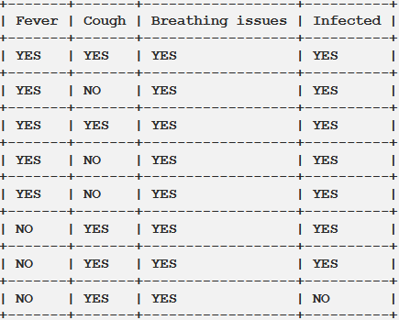
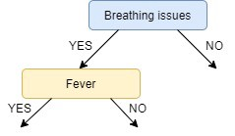
IG(Sʙʏ, Fever) = 0.20
IG(Sʙʏ, Cough) = 0.09
IG of Fever is greater than that of Cough, so we select Fever as the left branch of Breathing Issues:
Our tree now looks like this:

Slide 28
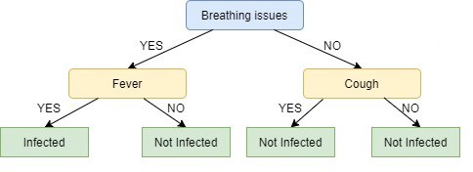

Slide 29
ID3: Algorithm
Calculate the Information Gain of each feature.
Considering that all rows don’t belong to the same class, split the dataset S into subsets using the feature for which the Information Gain is maximum.
Make a decision tree node using the feature with the maximum Information gain.
If all rows belong to the same class, make the current node as a leaf node with the class as its label.
Repeat for the remaining features until we run out of all features, or the decision tree has all leaf nodes.

Slide 30
ID3
Hence, information gain of weight is highest and so weight is selected as root node
Similarly by calculating subclass entropy decision tree can ne generated

Slide 31
Neural networks are computing systems with interconnected nodes that work much like neurons in the human brain.
Using algorithms, they can recognize hidden patterns and correlations in raw data, cluster and classify it, and – over time – continuously learn and improve.
Neural Networks

Slide 32
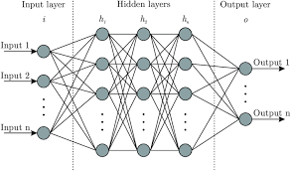
1. Artificial Neural Networks (ANN)
Artificial neural networks (ANNs), usually simply called neural networks (NNs), are computing systems inspired by the biological neural networks that constitute animal brains.
An ANN is based on a collection of connected units or nodes called artificial neurons, which loosely model the neurons in a biological brain.
Major Characteristics of Neural Network

Slide 33
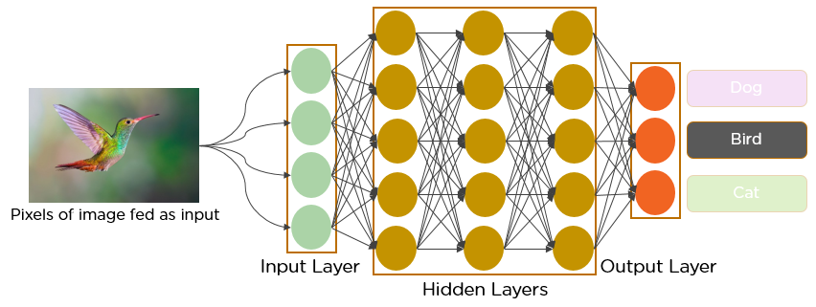
2. Convolution Neural Network
A convolutional neural network (CNN) is a type of artificial neural network used in image recognition and processing that is specifically designed to process pixel data
CNNs are powerful image processing, artificial intelligence (AI) that use deep learning to perform both generative and descriptive tasks, often using machine vison that includes image and video recognition, along with recommender systems and natural language processing (NLP).

Slide 34
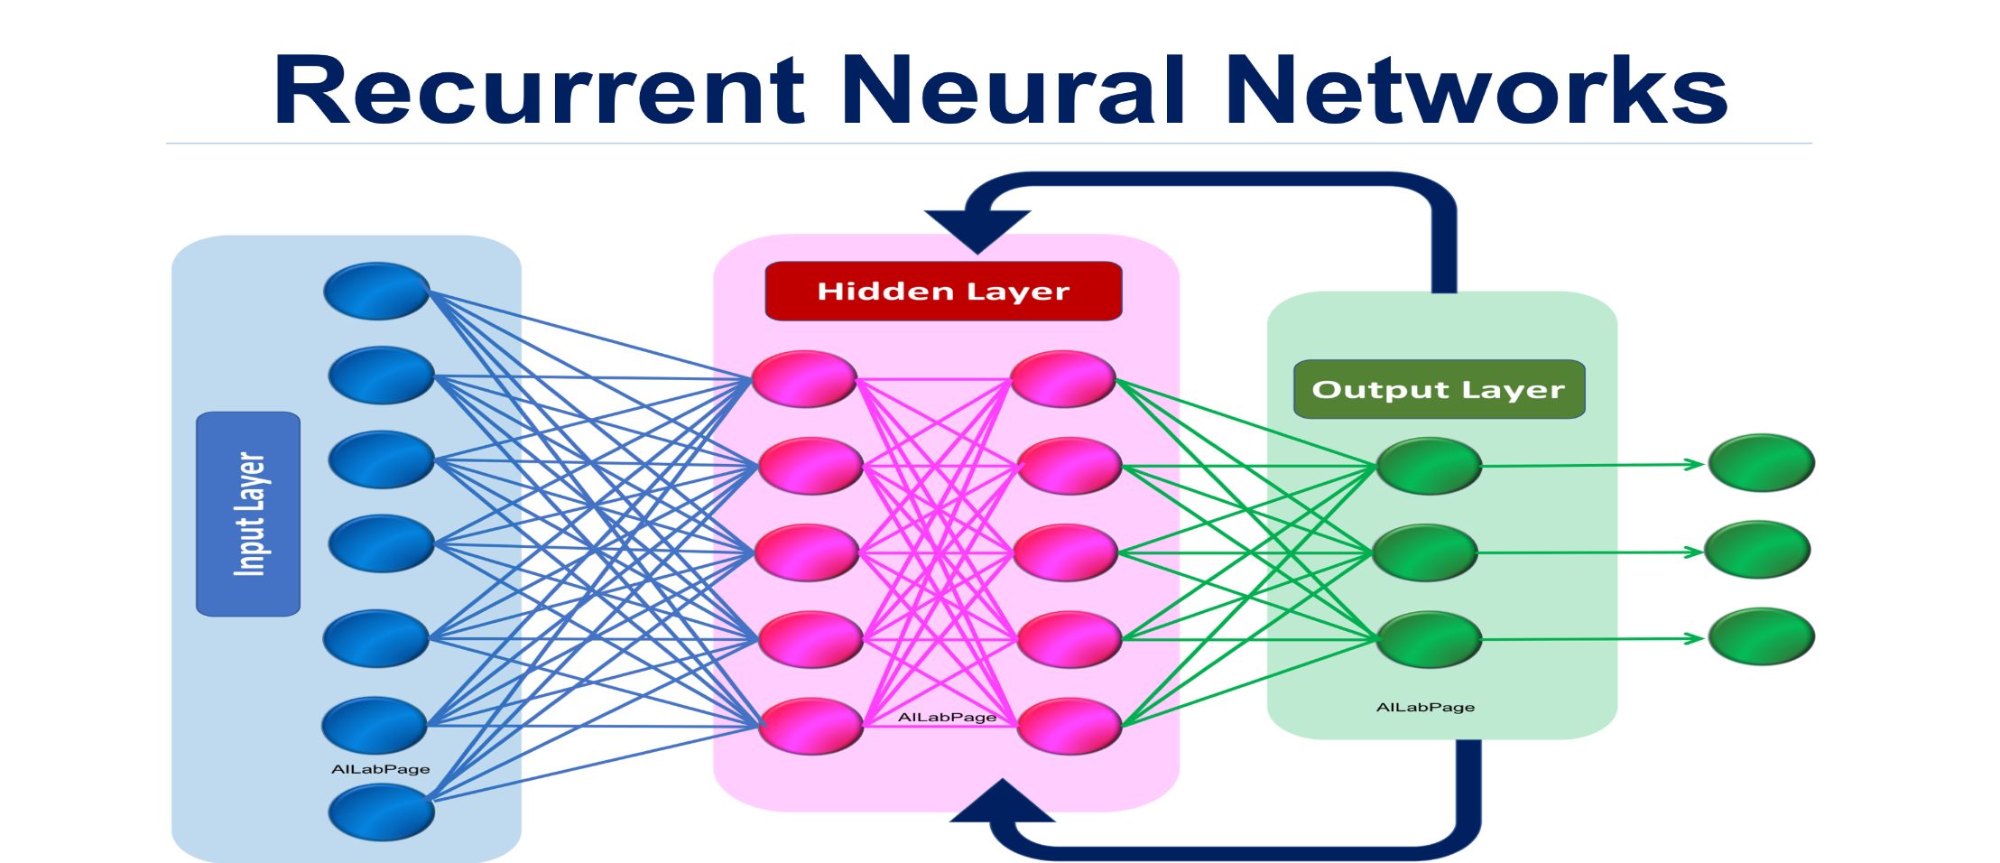
3. Recurrent Neural Network
Recurrent neural networks (RNN) are the state of the art algorithm for sequential data and are used by Apple's Siri and and Google's voice search.
It is one of the algorithms behind the scenes of the amazing achievements seen in deep learning over the past few years.

Slide 35
Boltzmann Machine
It is a network of neurons in which all the neurons are connected to each other. In this machine, there are two layers named visible layer or input layer and hidden layer.
The visible layer is denoted as v and the hidden layer is denoted as the h.
In Boltzmann machine, there is no output layer.
Boltzmann machines are random and generative neural networks capable of learning internal representations and are able to represent and (given enough time) solve tough combinatoric problems.
Very slow learning
For searching, Boltzmann machine has fixed weights on the connection but for learning weights use small update

Slide 36
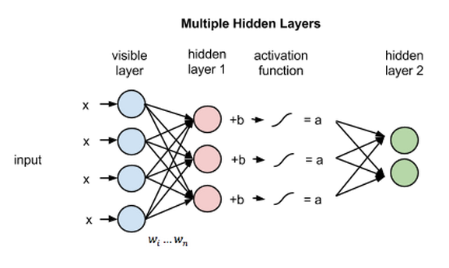
Boltzmann machines are typically used to solve different computational problems such as, for a search problem, the weights present on the connections can be fixed and are used to represent the cost function of the optimization problem

Slide 37
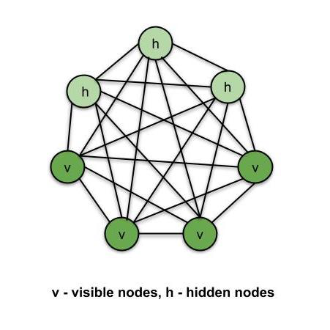

Slide 38
Fuzzy Logic
Fuzzy Logic resembles the human decision-making methodology and deals with vague and imprecise information.
Fuzzy logic is a concept of partial truth where true value may range between completely true or completely false
Fuzzy Logic resembles the human decision-making methodology. It deals with vague and imprecise information.
This is gross oversimplification of the real-world problems and based on degrees of truth rather than usual true/false or 1/0 like Boolean logic.

Slide 39
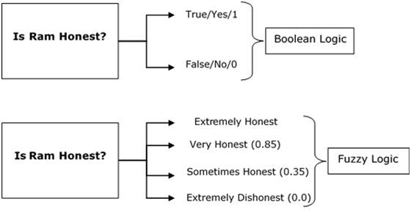
Fuzzy Logic
Take a look at the following diagram. It shows that in fuzzy systems, the values are indicated by a number in the range from 0 to 1.
Here 1.0 represents absolute truth and 0.0 represents absolute falseness. The number which indicates the value in fuzzy systems is called the truth value.

Slide 40
In other words, we can say that fuzzy logic is not logic that is fuzzy, but logic that is used to describe fuzziness.
There can be numerous other examples like this with the help of which we can understand the concept of fuzzy logic.
Fuzzy Logic was introduced in 1965 by Lofti A. Zadeh in his research paper “Fuzzy Sets”.
He is considered as the father of Fuzzy Logic

Slide 41
Fuzzy Logic
Fuzzy logic reflects how two people think it attempts to model our sense of our decision making and our common sense
In fuzzy theory, fuzzy set A of universe X is defined by function U_{a}(x) called membership function of set A
U_{a}(x):X→[0,1],
where, U_{a}(x) =1 if x is totally in A
=0 if x is not in A
0< U_{a}(x)<1, if x is partly in A.

Slide 42
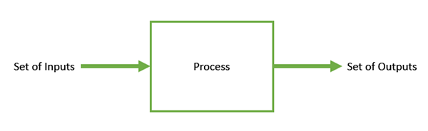
Genetic Algorithm
Genetic Algorithm (GA) is a search-based optimization technique based on the principles of Genetics and Natural Selection.
It is frequently used to find optimal or near-optimal solutions to difficult problems which otherwise would take a lifetime to solve.
It is frequently used to solve optimization problems, in research, and in machine learning.
Optimization is the process of making something better. In any process, we have a set of inputs and a set of outputs as shown in the following figure.

Slide 43
Genetic Algorithms (GAs) are search based algorithms based on the concepts of natural selection and genetics. GAs are a subset of a much larger branch of computation known as Evolutionary Computation.
GAs were developed by John Holland and his students and colleagues at the University of Michigan, most notably David E. Goldberg and has since been tried on various optimization problems with a high degree of success.
In GAs, we have a pool or a population of possible solutions to the given problem.
These solutions then undergo recombination and mutation (like in natural genetics), producing new children, and the process is repeated over various generations.
Each individual (or candidate solution) is assigned a fitness value (based on its objective function value) and the fitter individuals are given a higher chance to mate and yield more “fitter” individuals.
This is in line with the Darwinian Theory of “Survival of the Fittest”.

Slide 44
Advantages of GAs
GAs have various advantages which have made them immensely popular. These include −
Does not require any derivative information (which may not be available for many real-world problems).
Is faster and more efficient as compared to the traditional methods.
Has very good parallel capabilities.
Optimizes both continuous and discrete functions and also multi-objective problems.
Provides a list of “good” solutions and not just a single solution.
Always gets an answer to the problem, which gets better over the time.
Useful when the search space is very large and there are a large number of parameters involved.
Limitations of GAs
Like any technique, GAs also suffer from a few limitations. These include −
GAs are not suited for all problems, especially problems which are simple and for which derivative information is available.
Fitness value is calculated repeatedly which might be computationally expensive for some problems.
Being stochastic, there are no guarantees on the optimality or the quality of the solution.
If not implemented properly, the GA may not converge to the optimal solution

Slide 45
Genetic Algorithm
Cross over point is randomly chosen for crossing of strings, which yields offspring for each generation
Each individual of next generation offspring is subjected to random mutation with a small independent probability
The primary advantage of GA comes from crossover operation
GA combines an uphill tendency with random exploration and exchange of information among parallel search threads
GA has widespread impact on optimization problem such as circuit layout and job scheduling

